Slide 1
The Formation and Thermal Evolution of Itokawa’s Parent Body
Jonas Hallstrom¹ and Maitrayee Bose²
¹Department of Physics, Arizona State University
²School of Earth and Space Exploration, Arizona State University
Statewide Symposium, Arizona State University, April 2023

Slide 2
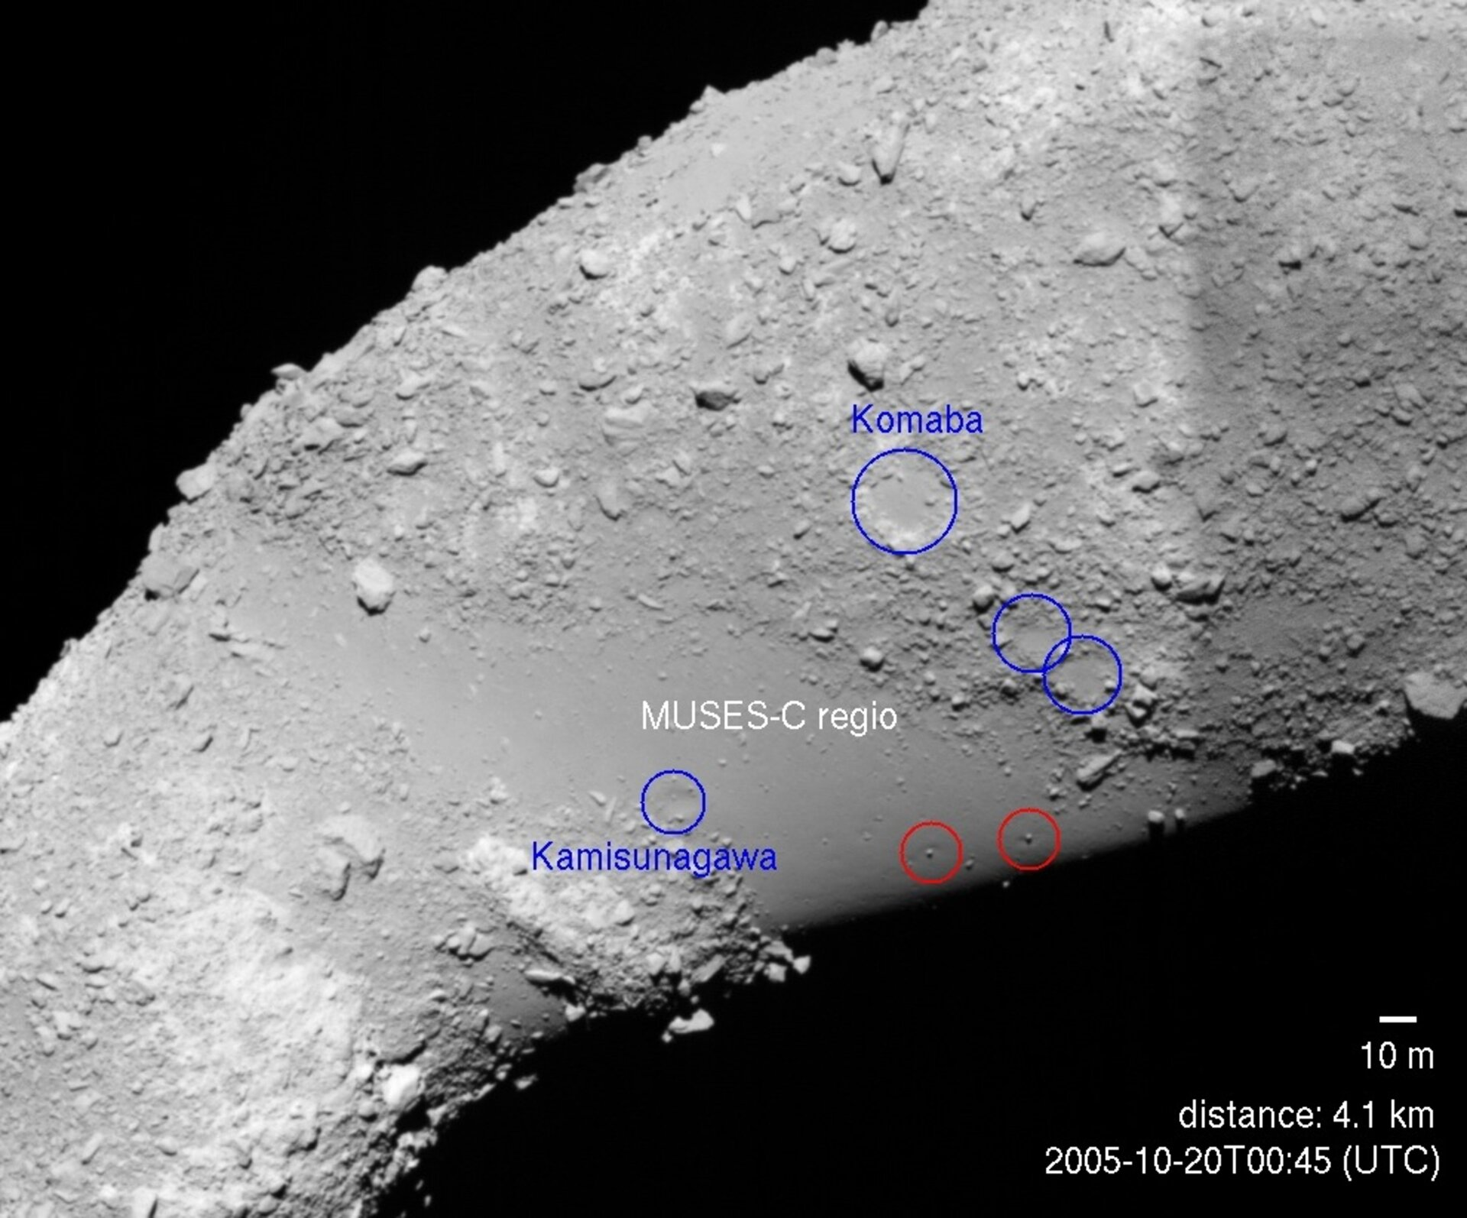
Introduction
10-200+ km asteroid parent bodies formed during the first few million years of the solar system
Several parent bodies were heated to >1000 Kelvin, mainly due to the decay of 26-Aluminum
Thermal evolution models can constrain the size and time of formation of parent bodies
Source: UK Polar Meteorite Exploration
25143 Itokawa, Source: JAXA

Slide 3
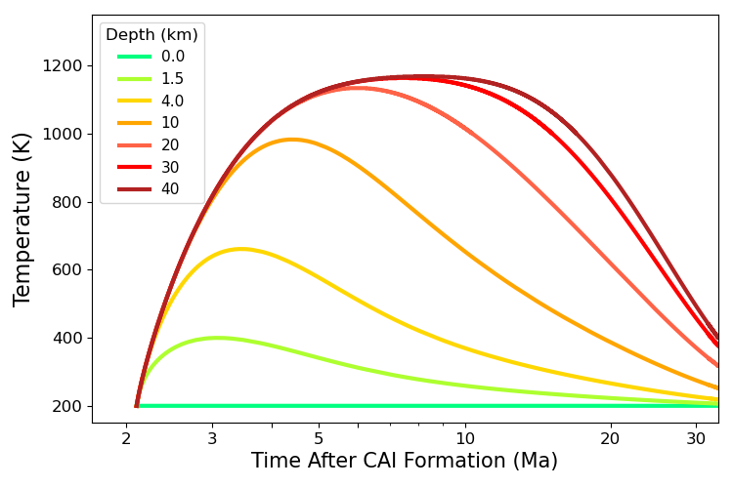
Methods
Itokawa’s parent body parameters:
$c_{p}$ and $κ$: thermal properties of OCs [1]
$h$: aluminum abundance of LL OCs [2]
$c_{p}\frac{∂T}{∂t}=\frac{1}{r^{2}}\frac{∂}{∂r}\left(r^{2}κc_{p}\frac{∂T}{∂r}\right)+h$
40 km radius body formed at 2.1 Ma
[1] Yomogida and Matsui 1984, EPS [2] Jarosewich 1990, MAPS

Slide 4
Itokawa’s parent body parameters:
$c_{p}$ and $κ$: thermal properties of OCs [1]
$h$: aluminum abundance of LL OCs [2]
Itokawa thermal constraints [3−5]:
Peak temperature: 1073-1273 K
Central temperature at 7.6 Ma: >973 K
$c_{p}\frac{∂T}{∂t}=\frac{1}{r^{2}}\frac{∂}{∂r}\left(r^{2}κc_{p}\frac{∂T}{∂r}\right)+h$
40 km radius body formed at 2.1 Ma
[1] Yomogida and Matsui 1984, EPS [2] Jarosewich 1990, MAPS
[3] Nakamura et al. 2011, Sci. [4] Wakita et al. 2014, MAPS
[5] Yurimoto et al. 2011, Sci.

Slide 5
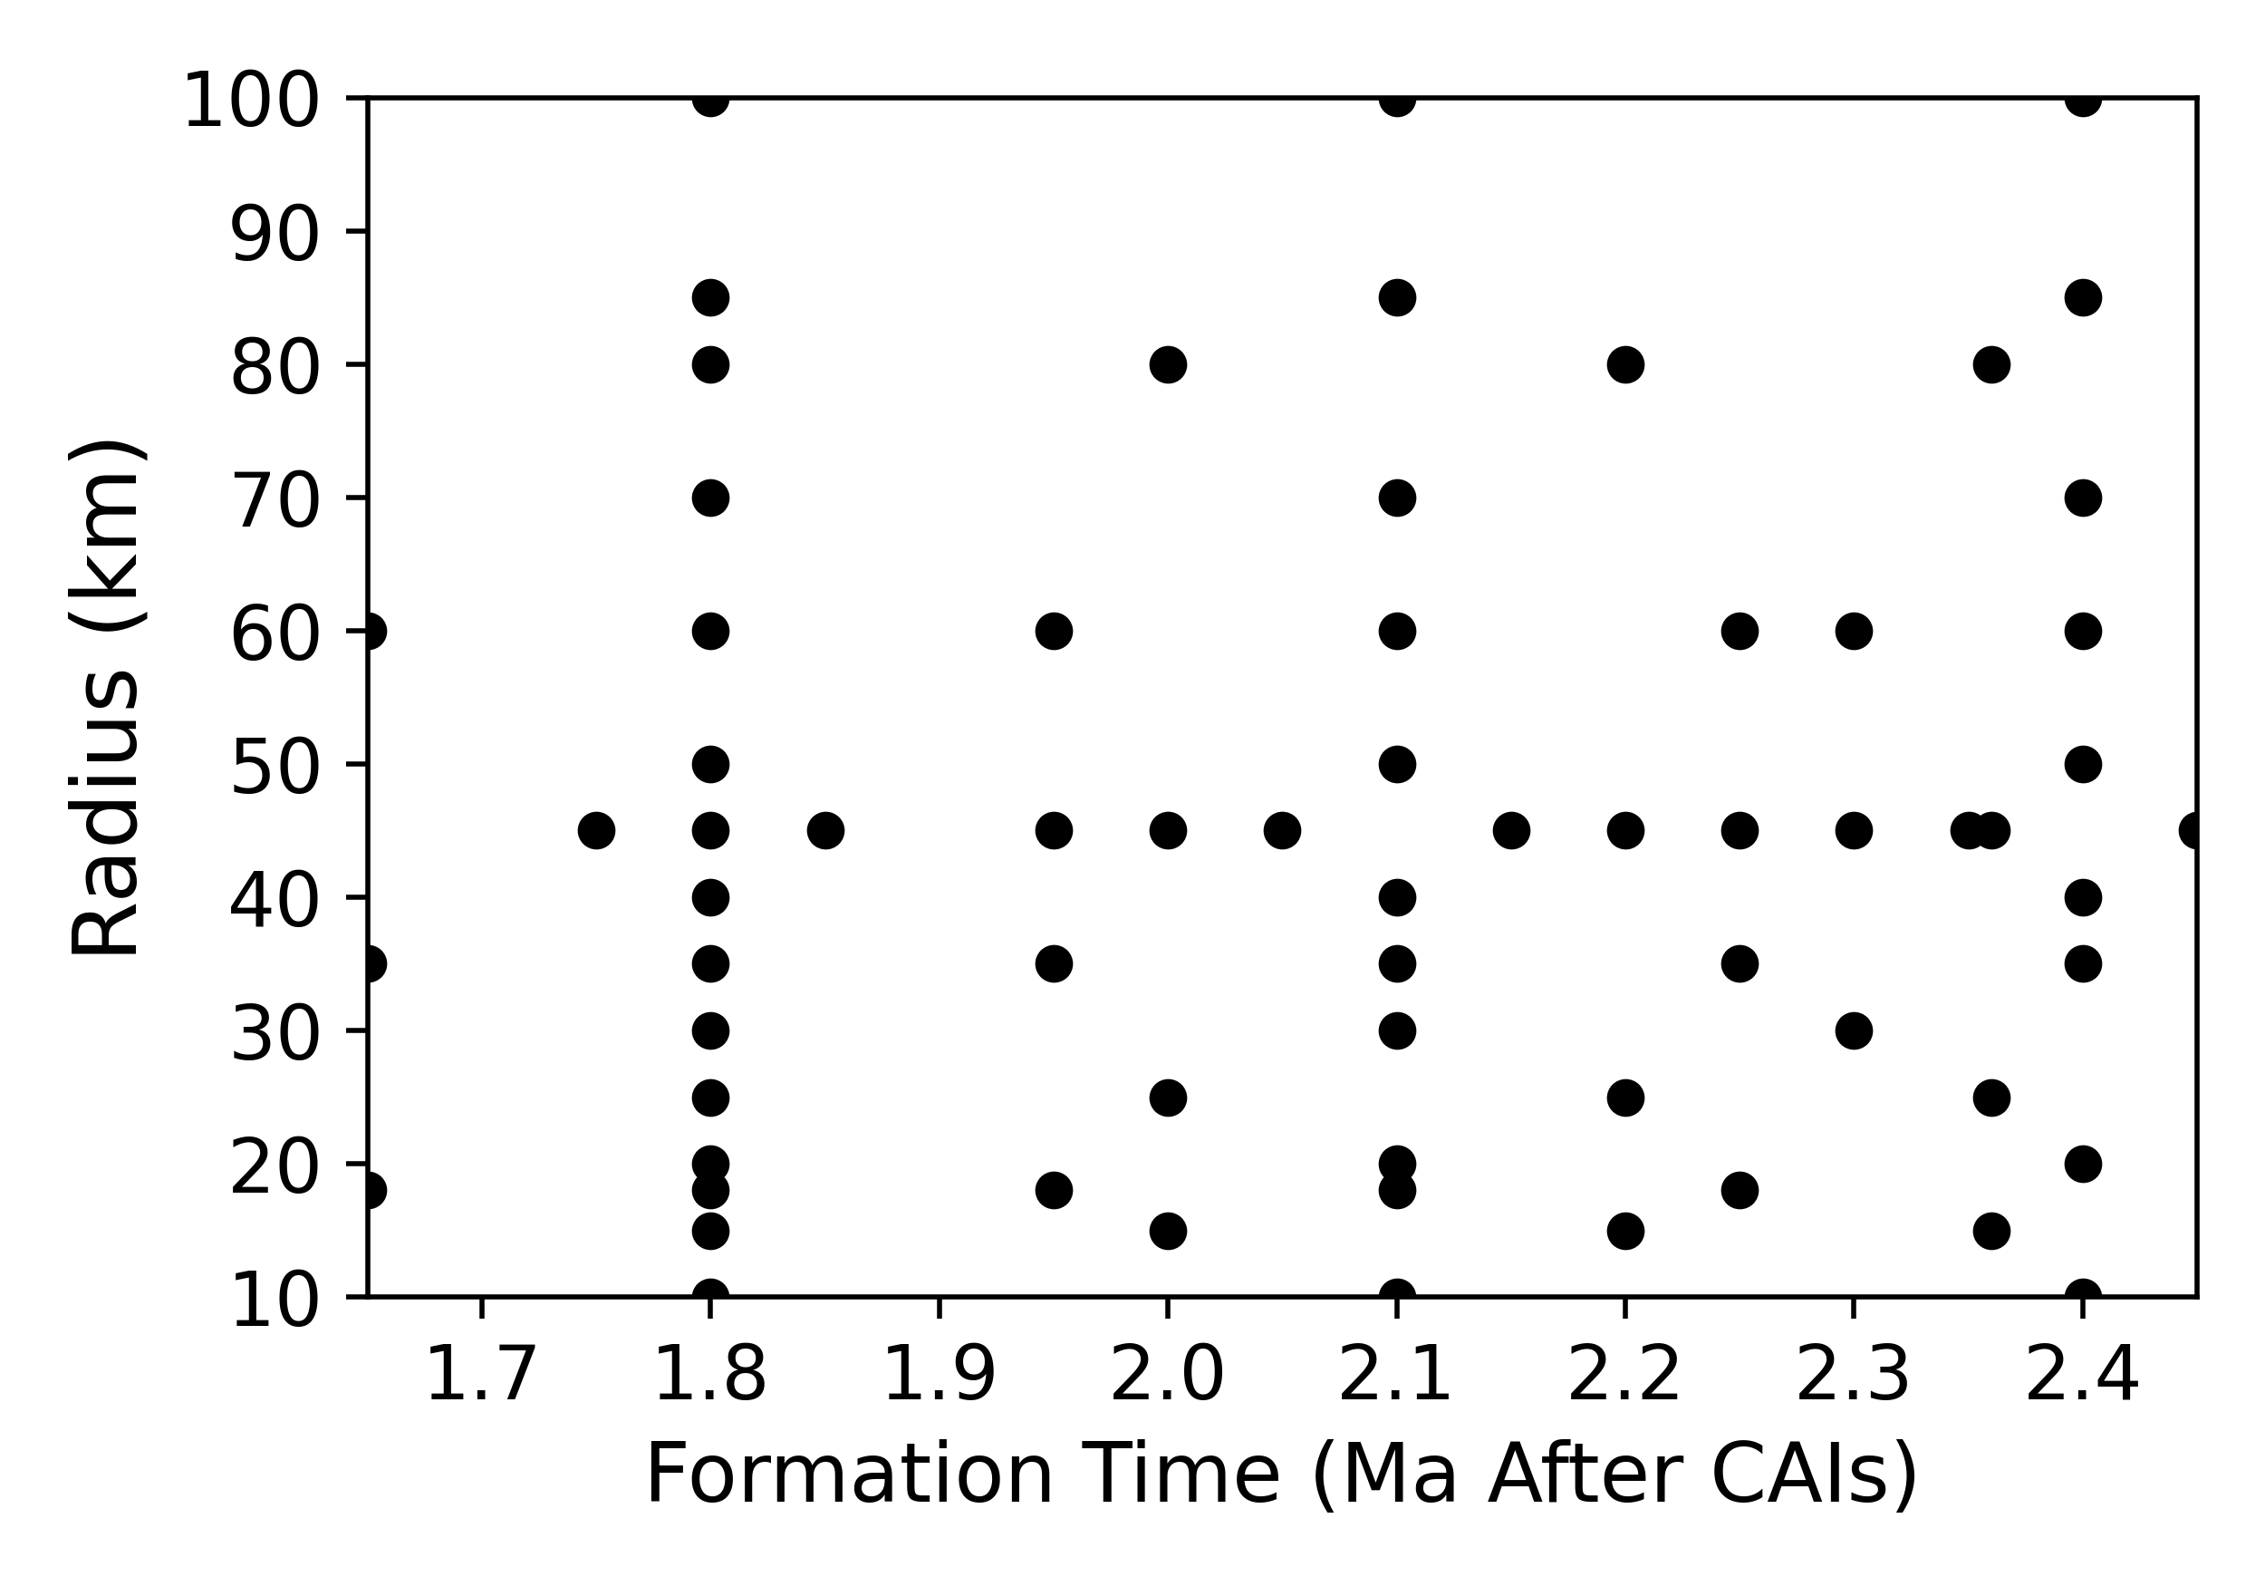
40 km radius body formed at 2.1 Ma
Notes:
We start off by simulating many parent bodies with reasonable radius and formation time values. This graph on the left shows the radius and formation time values of all the simulations performed.
So the 40 kilometer radius body formed at 2.1 million years would be represented by this orange dot on the graph.

Slide 6
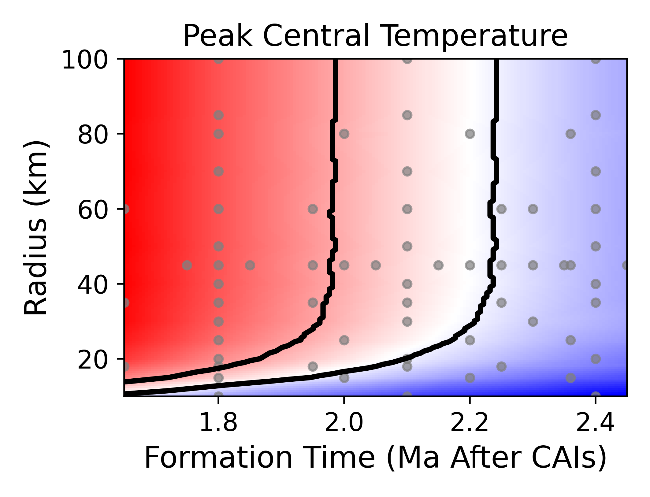
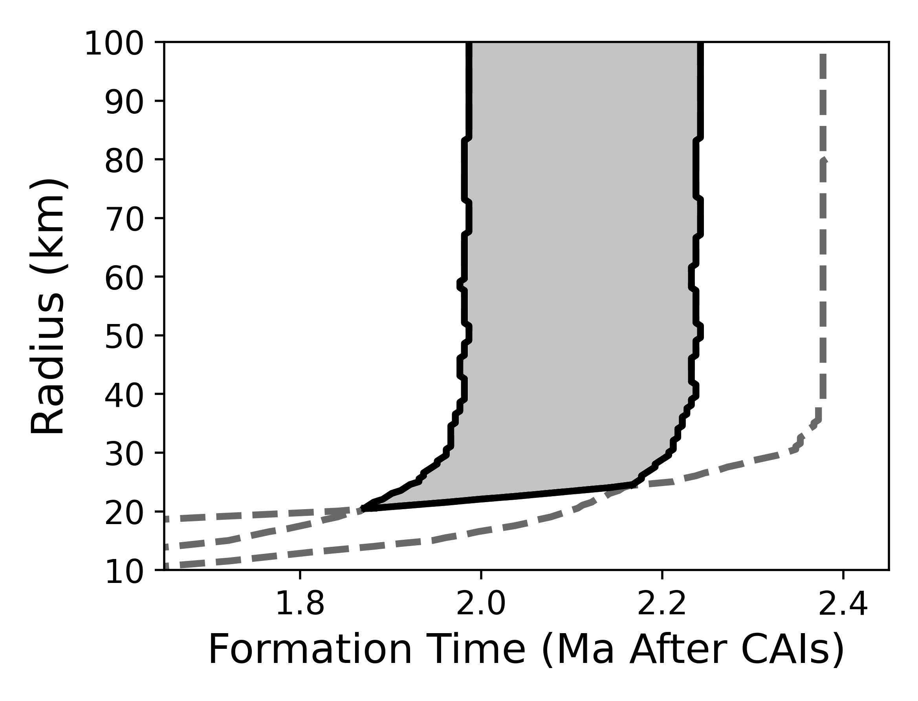
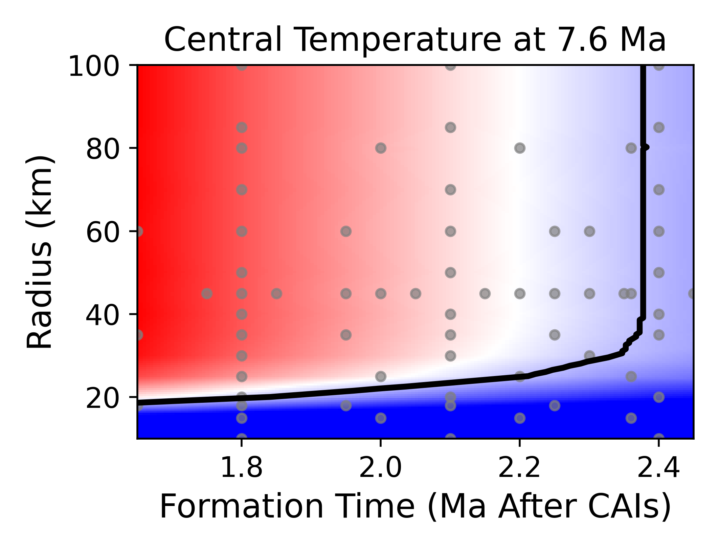
1273 K
1073 K
973 K
Itokawa parent body: formation time between 1.9 and 2.2 Ma, radius >20 km
Agrees with Wakita et al. (2014) MAPS

Slide 7
 | Base Value* | Range of Uncertainty | Data Sources
Aluminum Abundance | 1.18 wt.% | 0.86 to 1.16 | Jarosewich 1990, MAPS Sugiura and Fujiya 2014, MAPS
Specific Heat Capacity, $c_{p}$ | 1080 $\frac{J}{kg∙K}$ | 0.9 to 1.1 | Yomogida and Matsui 1984, EPS Henke et al. 2012, A&A Flynn et al. 2018, Chem. Erde
Thermal Diffusivity, $κ$ | 2.59$∙{10}^{−7} \frac{m^{2}}{s}$ | 0.9 to 3.0 | Yomogida and Matsui 1984, EPS Henke et al. 2016, A&A
*The given base values of$κ$ and $c_{p}$ are at T=1173 K
Hallstrom and Bose 2023, EPS

Slide 8
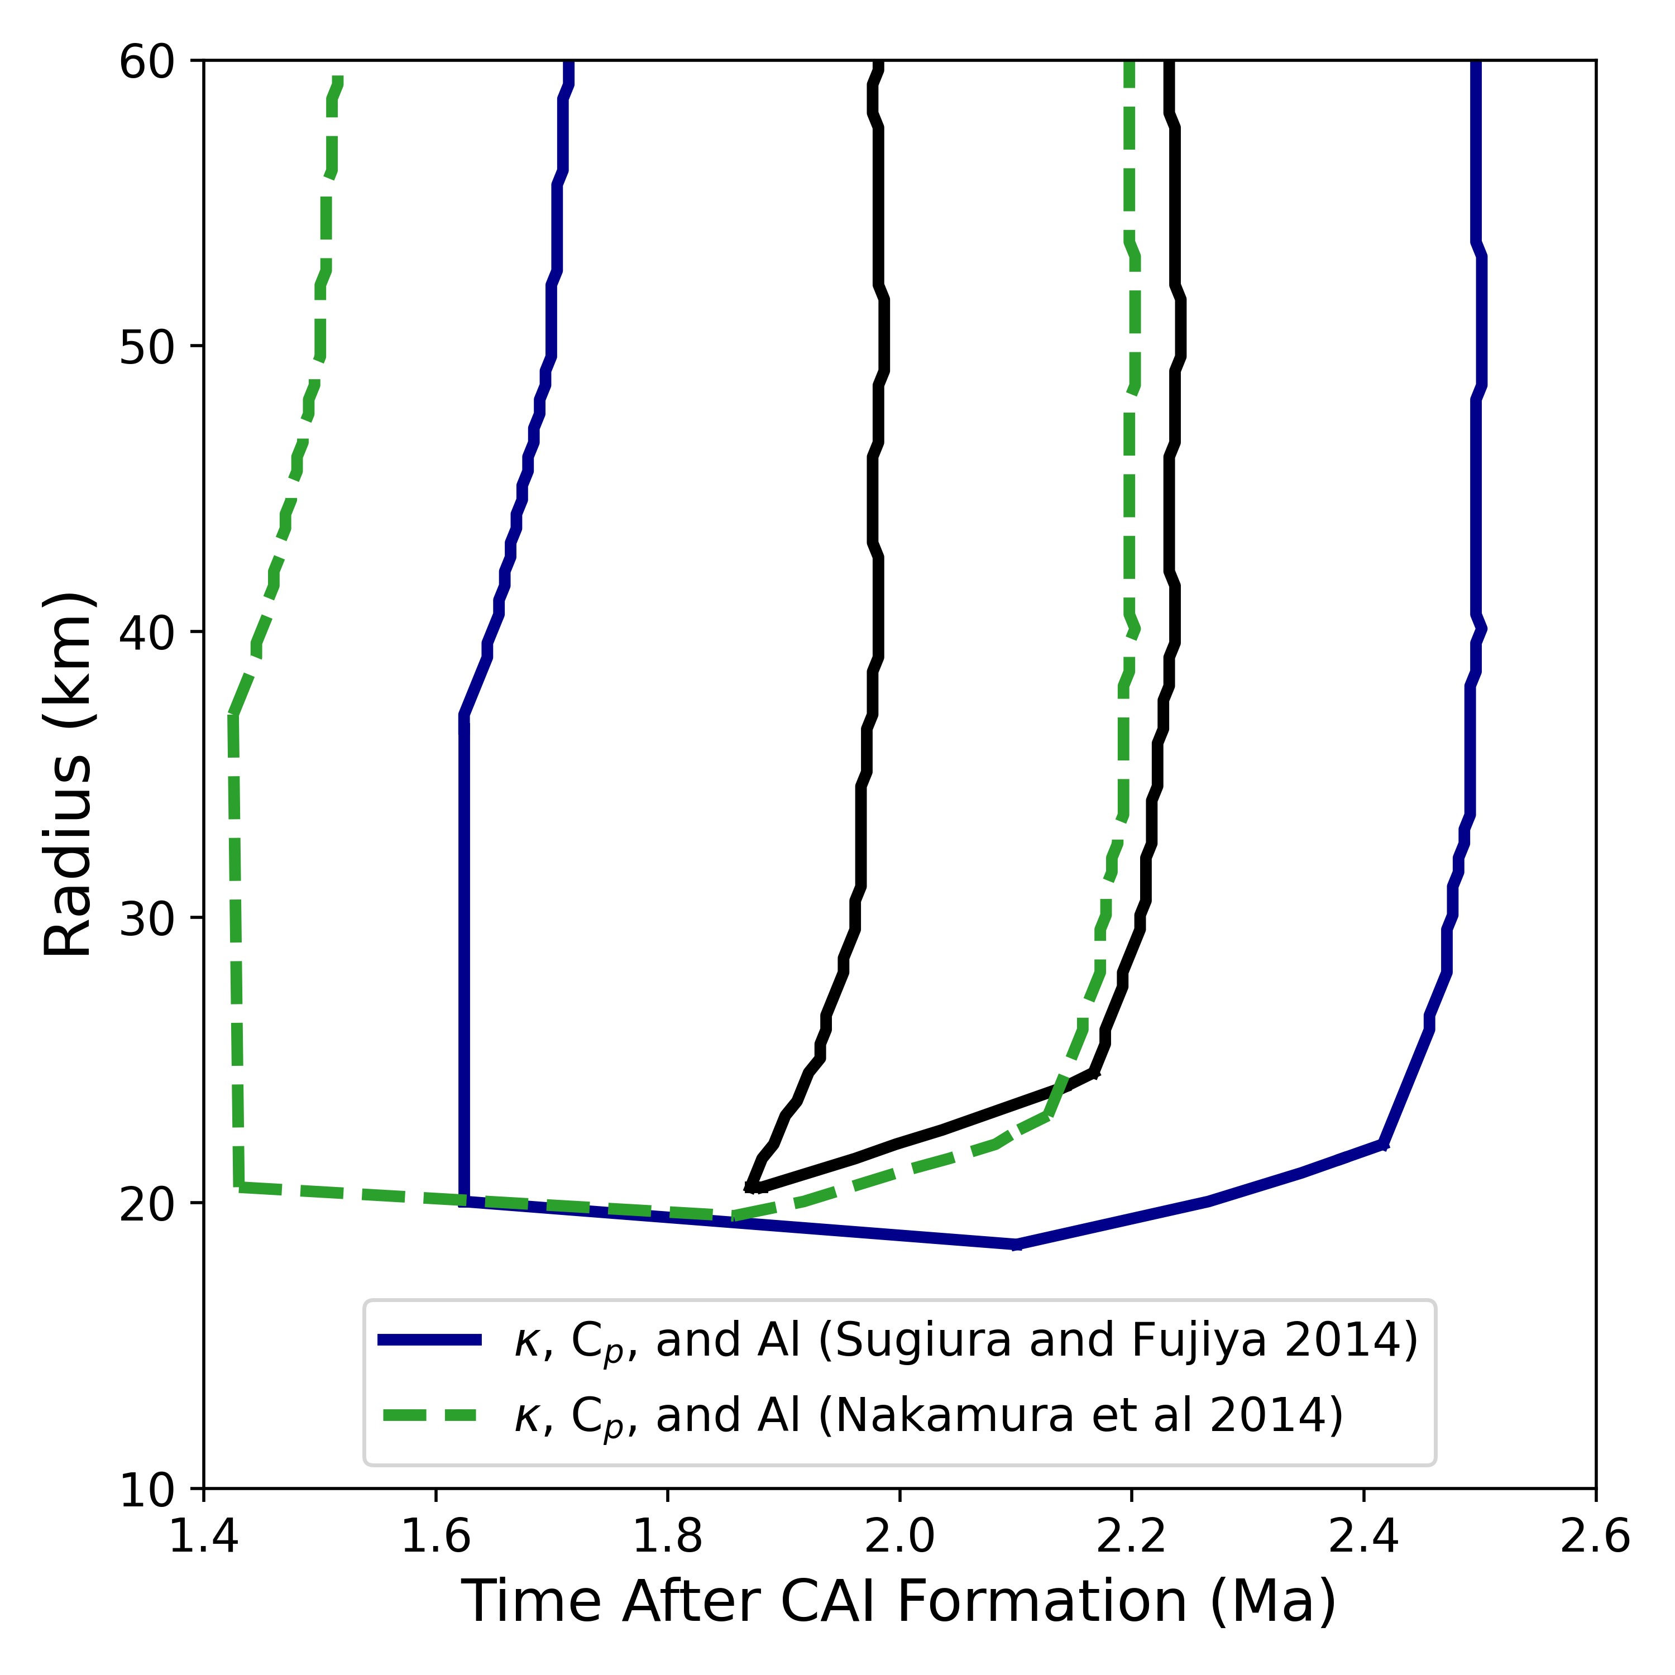
Results
Effects of material property uncertainty:
15% uncertainty in Al abundance gives ~0.3 Ma wider formation time range
10% uncertainty in C_{P} → ~0.2 Ma wider
Two datasets for aluminum abundance:
Sugiura and Fujiya (2014) MAPS: OCs give 0.86-1.16 times base value
Nakamura et al. (2014) MAPS: Itokawa particles give 0.71-0.87 times base

Slide 9
Conclusions
The formation time of Itokawa’s parent body is significantly less constrained than previously considered due to uncertainties in its material properties
Formation time window increased from 0.3 Ma to 0.9 Ma
More accurate values of thermal properties and aluminum abundance of relevant materials are required for effective thermal evolution models

Slide 10
Acknowledgements
Thanks most of all to Dr. Maitrayee Bose for her mentorship and support. I would also like to thank the rest of Dr. Bose’s research group for our discussions and the ASU/NASA Space Grant for funding this project.
Jonas Hallstrom, Arizona State University
More Information at: Hallstrom and Bose 2023, EPS
& github.com/JonasHallstrom/AsteroidThermalEvolution

